Slide 1

The Year 1, 2, 3 Team
Mrs Matthews Year 3
Mr Vaughan Year 2
Mrs Arrevillagas Year 1
Teaching Assistants:
Miss Sumaira and Mrs Leah (Year 3)
Miss Webb (Year 2)
Mrs Hadjam (Year 1)

Slide 2

Aims of the meeting
Give you some insight about how children are taught in school
Inform you about some of the day-to-day procedures in school
Provide some ideas for how families can help at home
A chance for you to ask any questions

Slide 3
Empowering Learning Skills
Six areas which underpins our teaching and we use for rewards –(linked to Monday celebration assembly)
Reflective learner
Team worker
Effective participator
Self manager
Independent enquirer
Resourceful thinker

Slide 4
Behaviour, Expectations and Rewards
Rewards
Praise
Certificates
Class dojos
House points
Sanctions
Traffic light system with 4 steps
Restorative approach
Some individually tailored plans

Slide 5

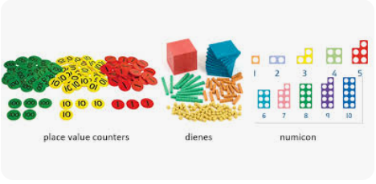
Maths
Taught daily
‘Fluency in 5’ practice at the start of each lesson
Variety of resources used including interactive whiteboard, number lines, number squares, counting objects
Concrete Pictorial Abstract
Arithmetic practice each week

Slide 6
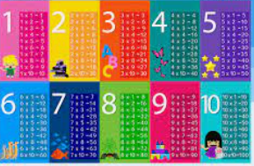
Times Tables
Year 1 – count in multiples of 2, 5 and 10, know doubles and halves to 10
Year 2 –multiplication and division facts for 2, 5 and 10 times tables (in any order).
TTRS gearing up to the national multiplication check in year 4 – 3,4 and 8 x tables expectation
Log-ins and passwords for Numbots and TTRS will be given out and are individualised so that access can be tailored.

Slide 7




English
Taught through texts to engage and interest whilst teaching all the components of writing for each year group.
Focus on: sentence writing basics and building accuracy, developing vocabulary, comprehension of text and structure of a story. As they go through the school, the range of writing opportunities and styles widens.

Slide 8

Phonics (Year 1 and 2)
Taught daily – Sounds Write (DfE approved scheme)
Teaches how sounds are represented by our writing system
Teaches three essential skills of segmenting, blending and phoneme manipulation
Children are taught as a whole class and additional intervention sessions will be delivered where needed.

Slide 9

Spellings (Year 1 and 2)
Every half term a ‘high frequency word’ spelling list will be set
First 10 or 20 words children cannot yet spell from those specified in the curriculum will be sent home to learn
Children to learn these words throughout the half term at home
Children will be tested on these words at the end of the half term and new lists will be sent home

Slide 10
Spellings (Year 3)
Taught 4 x weekly. Phonics consolidation group for those that may need that at this point.
The lessons for a week will focus on a specific spelling rule or pattern.
Children will be given a set of words based on this rule/pattern at the start of the week and will be tested on them a week later.
They will have worked on them in class but it would be great to support this at home.

Slide 11


Reading
Children have carefully tailored guided reading sessions four times per week in school – a mixture of adult led and independent activities.
Teaching children to read, not hearing children read.
Individualised reading packs also support reading independence in school as well as providing another chance for the children to be supported by the adults in school.
Home reading books are a level below what the children are working at in school. Given out on a Friday and returned by the following Wednesday please.

Slide 12
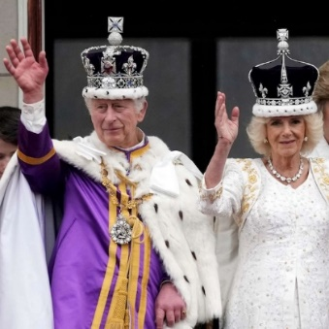
The Wider Curriculum
This half term’s challenge curriculum is:
The Struggle for Power, Control and Equality
This means learning about racial equality in Year 1, the role of monarchy and government in Year 2 and gender equality in Year 3.
Details of other curriculum coverage is on the overviews sent through the app with the welcome message and invite to this meeting.

Slide 13

Helping children at home
Reading with your child
Helping to learn spellings that are sent home
Times Table Rock Stars (Year 2 and 3) and Numbots (Year 1 and 2)
Helping children to learn through play and talk.

Slide 14

PE kits
Children should wear PE kits into school on the days they have sessions
Year 1: Monday and Friday
Year 2: Tuesday, Wednesday and Friday
Year 3: Wednesday and Friday
PE kit: Black/navy joggers, shorts or leggings, plain black trainers/PE pumps, white t-shirt and normal school jumper.

Slide 15

Attendance and Punctuality and General Information
Start/Finish times: 8:45 – 3:15pm
Please make sure you engage with staff when picking up your children, so that we can feel safe and secure in the knowledge of who they have gone home with.
Please let us or the office know in advance if someone else is going to be picking them up.

Slide 16

Questions

